Slide 1

Java Backend System
Extensible
Workflow Engine
Marlone Nyapwere
Group #3
Java Implementation
UML-Based Design
Plugin Architecture

Slide 2
02 / Project Foundation
Project Overview
Project Description
Technology Stack
This project develops an extensible backend workflow engine that models and executes business processes using object-oriented analysis and design techniques. A workflow is represented as a sequence of steps connected by conditional transitions, enabling dynamic execution paths based on runtime data.
Java
Primary Language
UML 2.5
Modeling Standard
The system separates workflow definition from execution, allowing new workflows and step types to be added without modifying the core engine—achieving true extensibility through clean architecture.
OOAD
Design Methodology
Plugin API
Core Principle
Design Approach
Extension Framework
Separation of concerns between definition, execution, and extension layers
UML-based analysis with use cases, robustness analysis, and detailed design
Key Objectives
Enable runtime workflow definition
Maintain execution state persistence
Support conditional branching logic
Provide plugin-based extensibility
Handle errors and failures gracefully
Deliver functional prototype

Slide 3
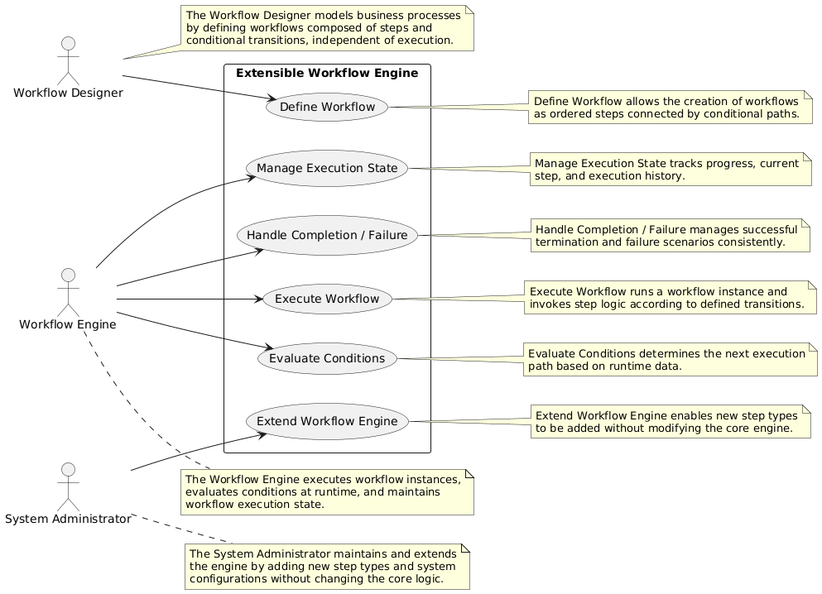
03 / Use Case Diagram
Use Case mode
Primary Actor
Workflow Designer – Models Business Processes by defining workflows composed of steps and conditional transitions, independent of executions
Secondary Actors
Workflow Engine – Executes workflow instances, executes conditions at runtime, and maintains workflow execution state.
Systems Administrator – maintains and extends the engine by adding new steps and system configurations without changing the core logic
Use Cases
Define Workflow, Execute Workflow, Evaluate Conditions Manage Execution State, Handle Completion / Failure Extend Workflow Engine

Slide 4
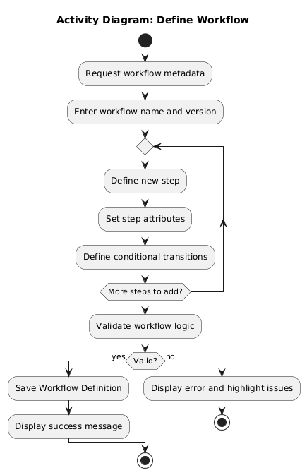
04 / Activity Diagrams
Define Workflow
Description
The Designer starts the process
The system prompts for workflow metadata.
The Designer enters the workflow name and version.
The system requests step definitions.
The Designer adds steps and defines transitions between them.
The system validates the workflow structure for loops or orphans.
The system saves the definition to the database.

Slide 5
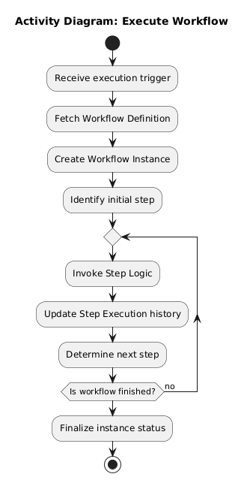
05 / Activity Diagrams
2. Execute Workflow
Description
The Engine receives a trigger to start a workflow.
The system fetches the Workflow Definition.
A new Workflow Instance is created.
The system identifies the initial step.
The step logic is invoked.
The system checks if the workflow has reached a termination point.

Slide 6
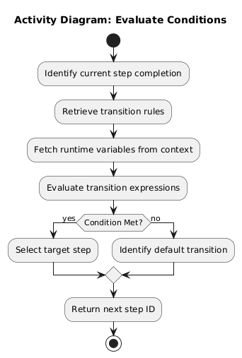
06 / Activity Diagrams
3. Evaluate Conditions
Description
The Engine completes a step and reaches a transition point.
The system retrieves transition rules.
The system fetches current variables from the Execution Context.
The system evaluates the expression against the data.
The system selects the valid target step.

Slide 7
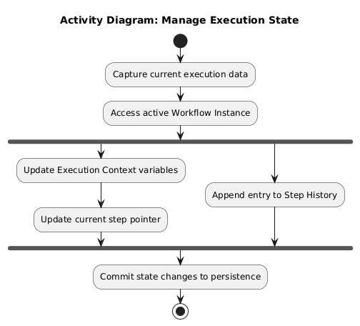
06 / Activity Diagrams
4. Manage Execution State
Description
The system detects a change in execution progress.
The system captures the current step ID and variable values.
The Execution Context is updated.
An entry is appended to the Step History.
The system confirms state persistence.

Slide 8
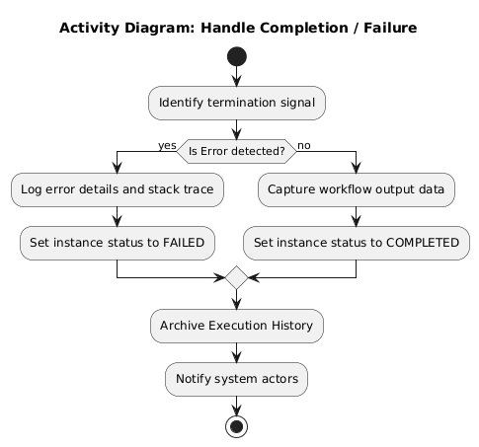
07 / Activity Diagrams
5. Handle Completion/ Failure
Description
The system identifies a completion signal or a runtime error.
The system evaluates the final status (Success or Failure).
The Workflow Instance status is updated.
The system records final output data or error logs.
Resources are released and the process ends.

Slide 9
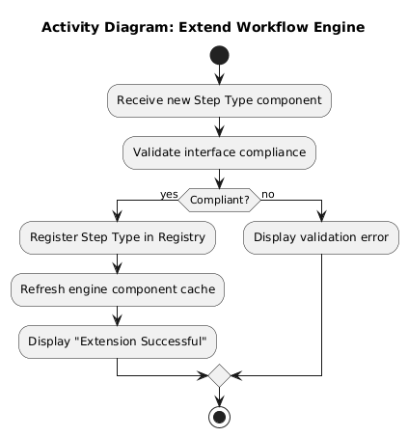
08 / Activity Diagrams
6. Extend Workflow Engine
Description
The System Administrator provides a new step type component.
The system validates the component against the standard Step interface.
The system registers the new type in the Extension Registry.
The registry is refreshed.
The new step type becomes available for the Workflow Designer.

